Slide 1
Rocky Mountain MIRECC TBI TOOLKIT: A HOW-TO GUIDE
Notes:
1) Recognition of the increased incidence of suicide among veterans – very quick intro
2) Discuss difference between screening and assessment.
Identifying tools for screening and how that differs from suicide risk assessment.
When to assess and what elements to cover during assessment
3) Identifying available resource in the VA and community.
Took out a few intro slides, why it matters for md’s, some of the roleplay, risk stratification—I think this is another talk.
Bring safety planning folders

Slide 2
Disclaimer
This presentation is based on work supported, in part, by the Department of Veterans Affairs, but does not necessarily represent the views of
the Department of Veterans Affairs or the United States Government.

Slide 3
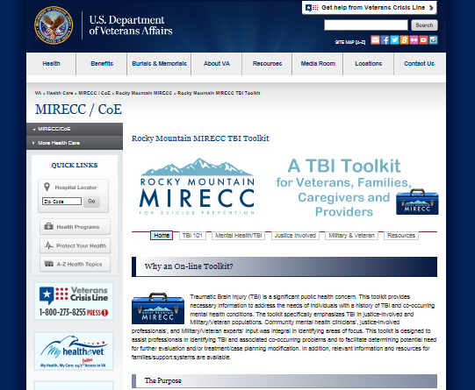
Rocky Mountain MIRECC
This toolkit is located on the Rocky Mountain MIRECC for Suicide Prevention Website: www.mirecc.va.gov/visn19/tbi_toolkit

Slide 4
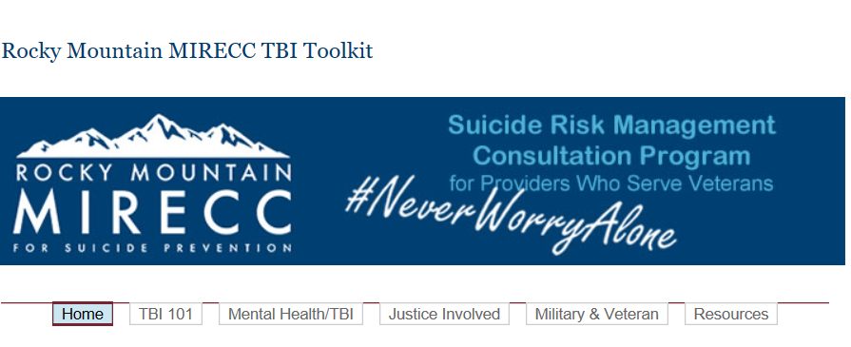
Welcome to the Toolkit!
The Home Page provides information about the following:
Purpose of the Toolkit
Structure
Funding sources
How to reach the authors for questions or feedback
www.mirecc.va.gov/visn19/tbi_toolkit/

Slide 5
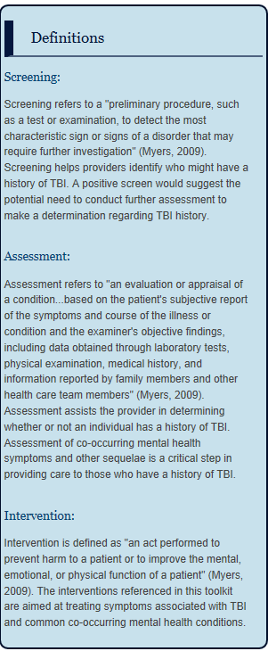
The Homepage also provides you with information about key definitions found throughout the toolkit
What is the difference between screening and assessment?
What kind of interventions will I find in the toolkit?

Slide 6
Site Navigation
The toolkit is comprised of sections about TBI in Military/Veteran and Correctional populations
The TBI 101, Mental Health/TBI and Justice Involved Pages include:
Background information/Education
Screening and Assessment Tools
Management Strategies
Interventions and Treatment Modification Suggestions
The Military and Veteran Page consists of introductory information about Military structure and links to help community professionals understand more about Military culture
The Resources page has additional links specifically for providers, for supports, and for Veterans

Slide 7
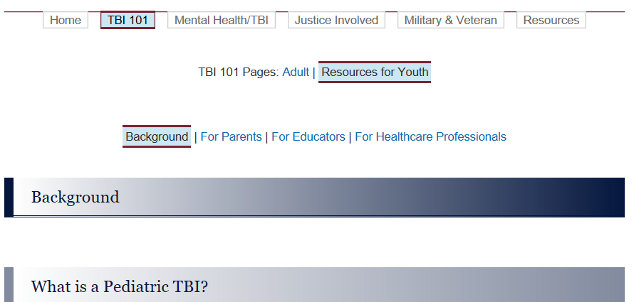
Viewing Information
Information is presented at a glance. For example, the TBI 101 page consists of information tabbed for “Adult” and “Resources for Youth.” You will see that under “Resources for Youth,” content of interest within that subject (i.e., “Background”) appears.

Slide 8
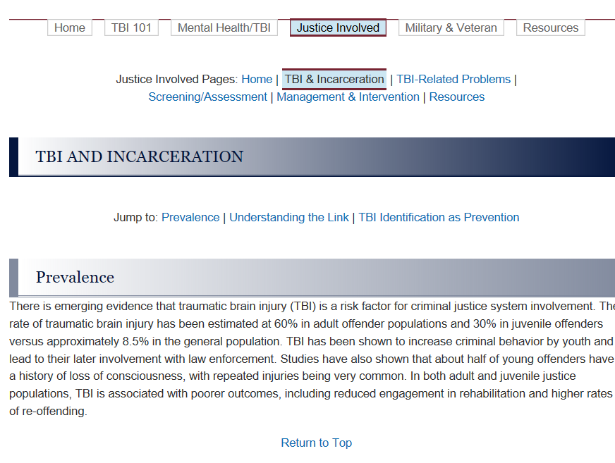
View desired information by clicking on the page of interest (i.e., “Justice Involved Page”). You can then select topics of interest within that page (i.e., “TBI & Incarceration”). Use the “Jump to” tabs to land onto relevant topic information (i.e., “Prevalence”). Click on the “Return to Top” tab to quickly get back to the page directory without having to scroll.

Slide 9
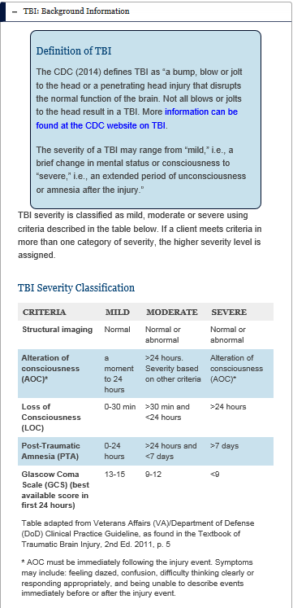
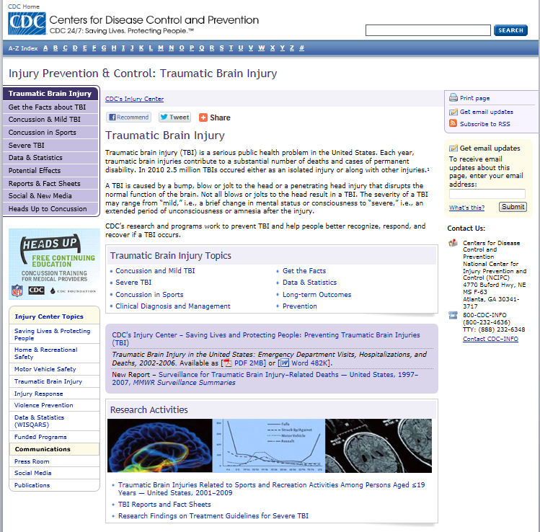
Within pages, you will find background information and links to additional information and resources.

Slide 10
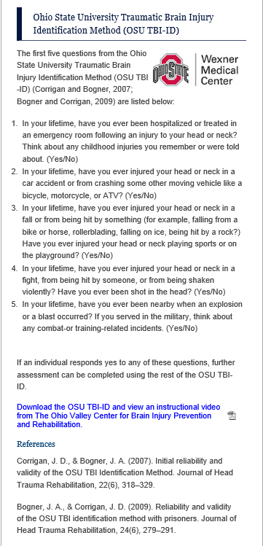
Links to resources will be demarcated in BLUE. A PDF symbol may also be present, indicating that the link provides a handout.

Slide 11
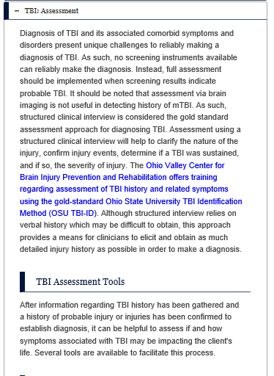
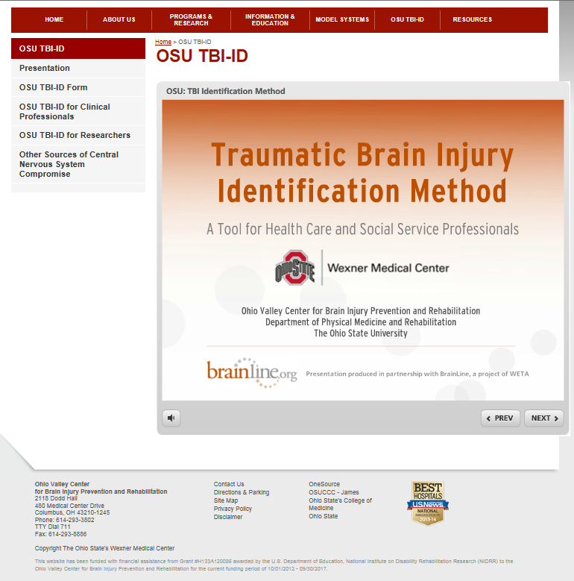
For example: Click on the link to get to the resource page of the gold standard for TBI assessment.

Slide 12
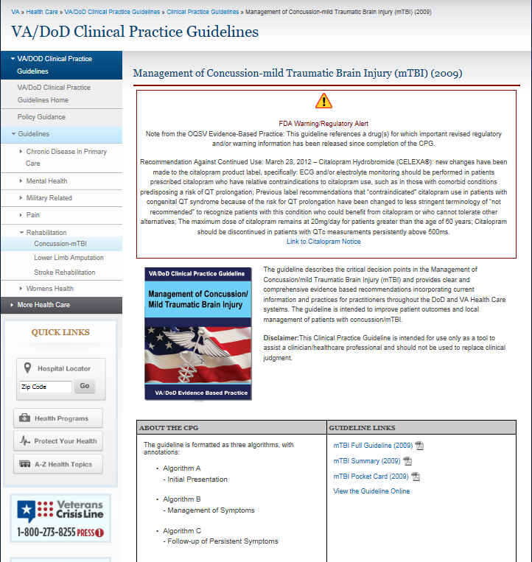
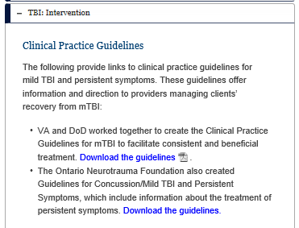
Click on the link to get to the resource page for further information and to download the copy of material

Slide 13
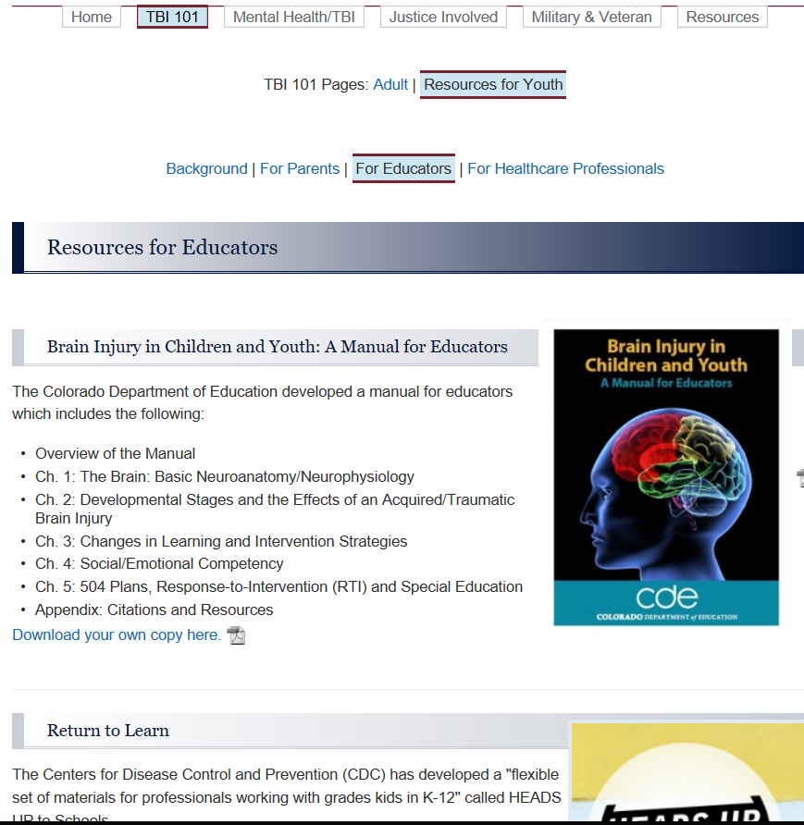

Slide 14
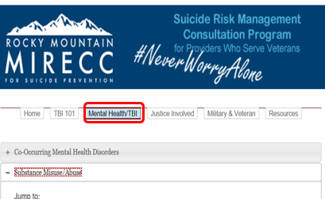
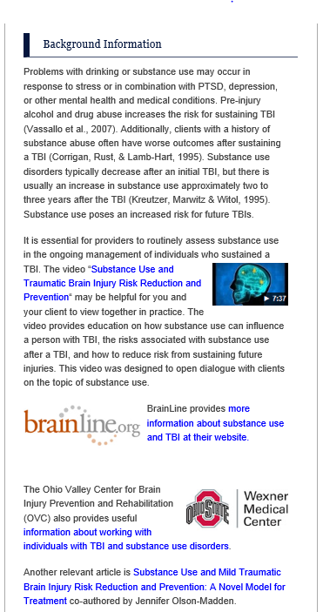
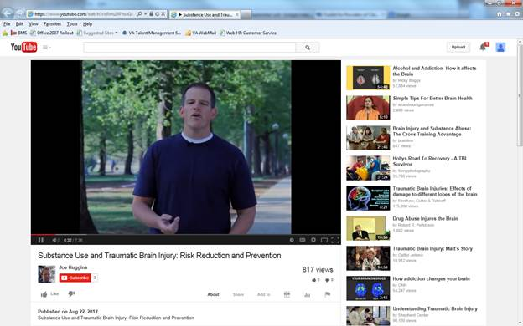

Slide 15
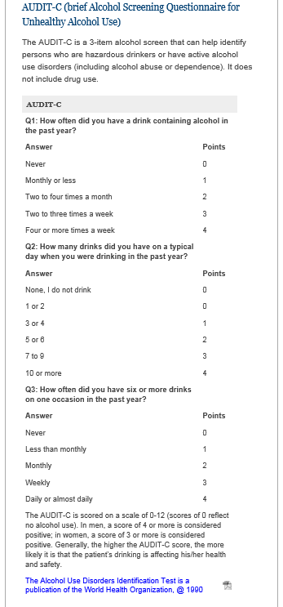
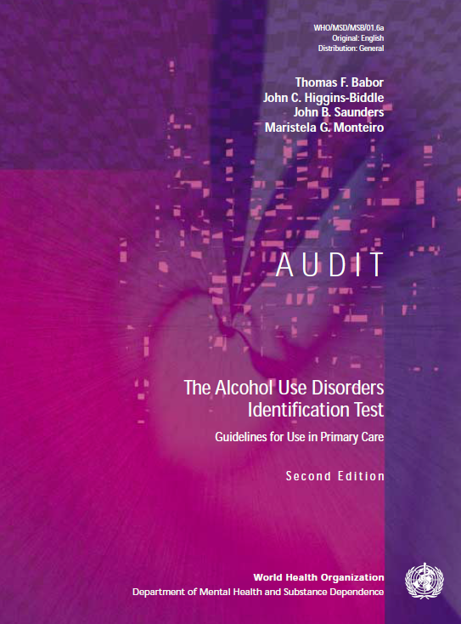
Visit the toolkit to access other available tools!

Slide 16
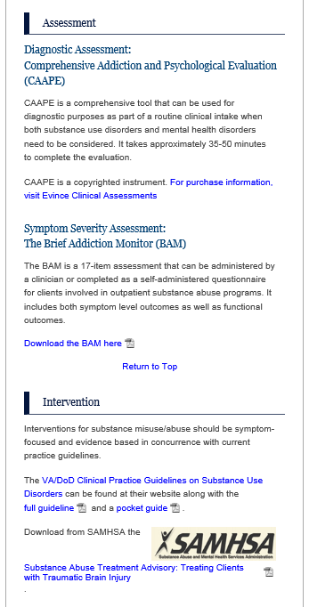
Information is provided to guide access to measures (i.e., purchase vs. download).
Tools for intervention are also provided!

Slide 17
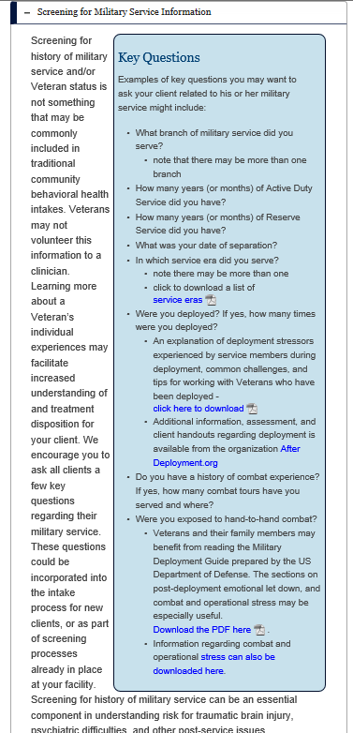
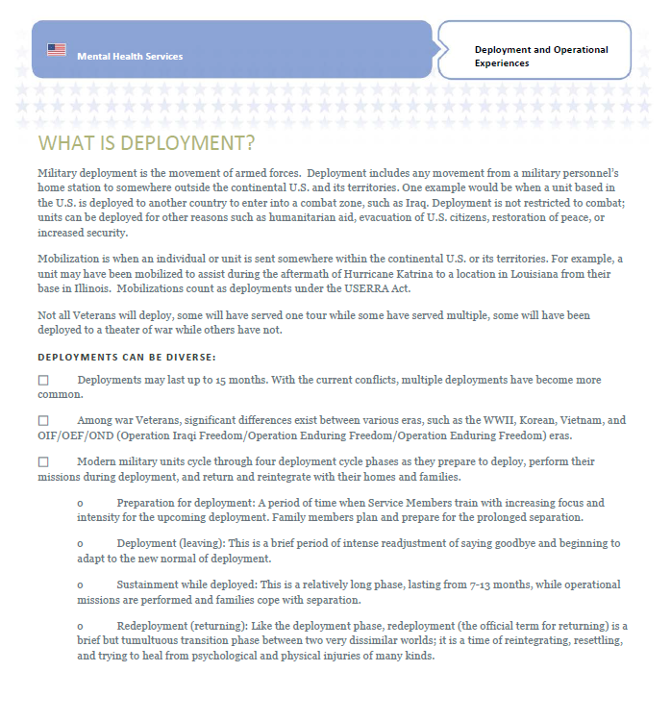
Above is one example of tools found in the Military/Veteran culture section

Slide 18
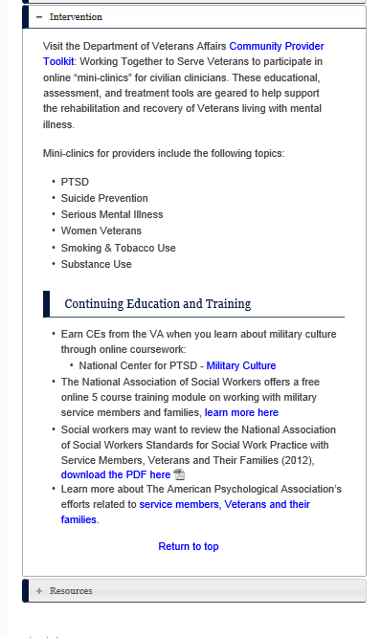
Several tools are available to facilitate culturally competent clinical practice.

Slide 19
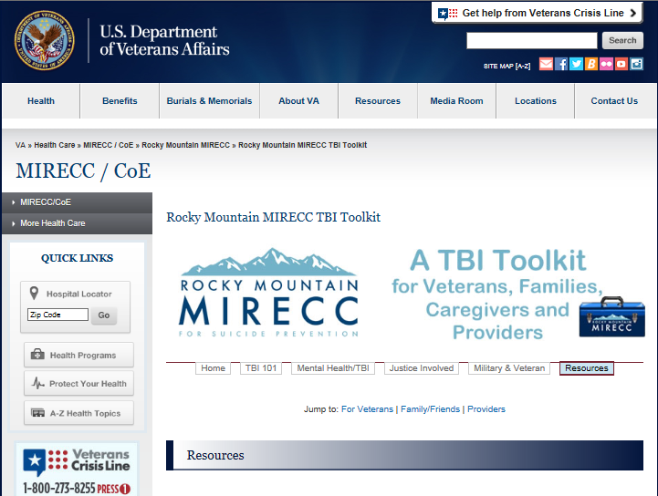
The Resources Page provides information for Veterans, for Family, Friends and Caregivers, and for Providers

Slide 20
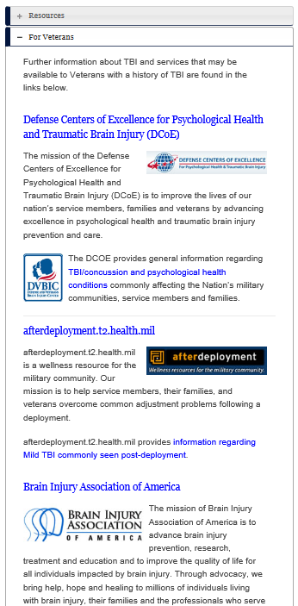
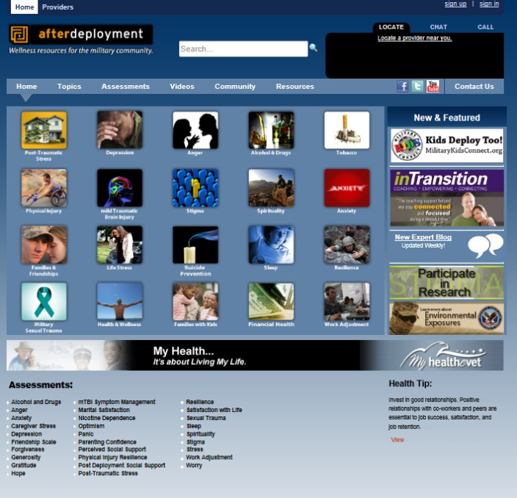
Resources for Veterans

Slide 21
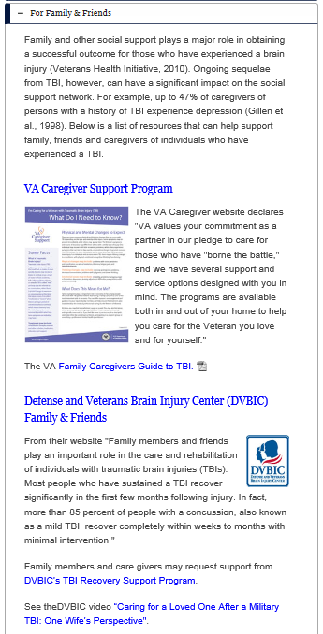
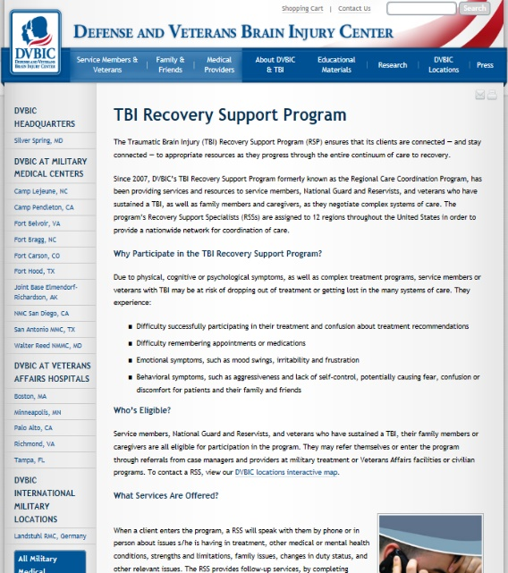
Resources for Family/Friends/
Supports

Slide 22
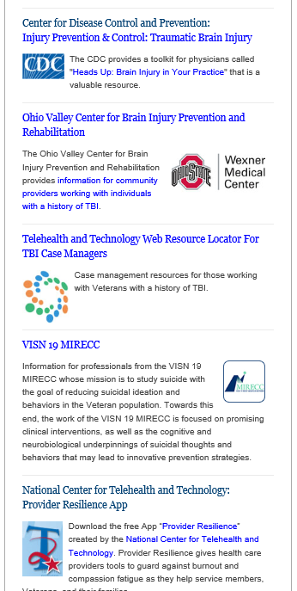
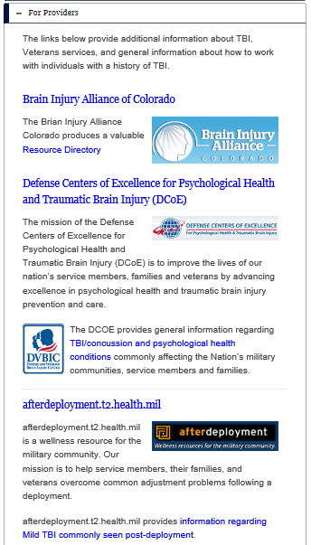
In addition to the other resources, be sure to visit the VISN 19/Rocky MountainMIRECC!

Slide 23
Thank you for visiting the Rocky Mountain MIRECC
TBI Toolkit!
For questions or feedback, please contact webpage manager Joe Huggins at joe.huggins@va.gov
Special thanks to the Co-Occurring Mental Health and TBI team for their contributions: Lisa Brenner, PhD, Bridget Matarazzo, PsyD, Jennifer Olson-Madden, PhD, and Gina Signoracci, PhD
And to the Justice-Involved TBI team for their contributions: Nazanin Bahraini, PhD, Lisa Brenner, PhD, and Jennifer Olson-Madden, PhD

